Slide 1
Choose your Dogstiny
Using NLP to identify features for your new best friend

Slide 2
Agenda
Introduction
Web Scraping
Data Cleaning
Techniques
Clustering
Evaluation
Best Results
Worst Results
Lessons Learned and Use Case
Conclusion

Slide 3
Introduction
A lot of pet finder websites rely on someone to select a breed first and then reading about it before selecting another breed to read about
Purpose of project is to create an application where you can look for features in a dog that fit your lifestyle and environment.
Project will show techniques used for web scraping, NLP, and clustering analysis to group dogs based on personality types
Personality types identified:
Follow the Leader
Nervous Nellies
Energy Stars
Protectors
Renaissance Dog

Slide 4
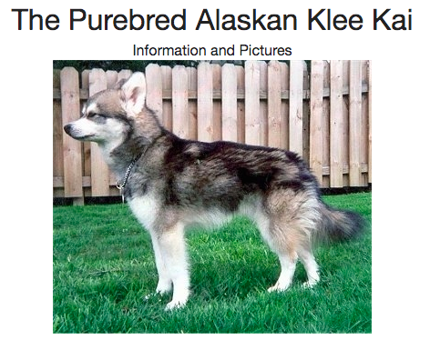
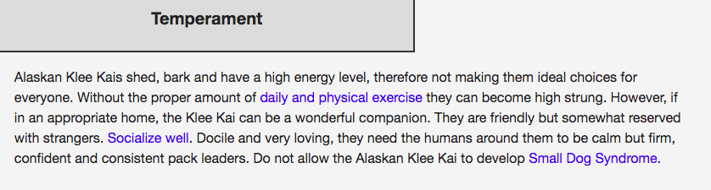
Where does my data come from?
Dog Breed Info: www.dogbreedinfo.com
The Dog Breed Info website provides the comprehensive descriptions of over 1000s of dog breeds.
The data used for this project will cover features as it pertains to temperament and energy level of dogs
I have chosen to focus on the pure breed dogs for this projects as our hybrid dogs share attributes of the dogs they are bred from and will create duplicative feature issues clustering.

Slide 5
Data cleaning
Extract data from website and clean via Web Scraping
Worked through an estimated count of 950 subpages which took around 30 minutes to run as part of the web scraping process
BeautifulSoup to remove HTML tags and metadata
Newly saved CSV file imported into Jupyter Notebook
Created loop to scrub out dog names from created column that did not fit certain length of characters
Aggregating and formatting data in correct shape to ensure correct format
Created stop word list with English stop words, plus other keywords that came up in dog breed pages

Slide 6
NLP Unsupervised Learning Techniques
Feature Engineering
PCA
t-SNE
Count Vectorizers (bigrams)
Tfidf Vectorizers (single word)
Clustering
K Means
Mini Batch
Mean Shift
Evaluation Methods
Silhouette Score

Slide 7
evaluation
Silhouette Score
Used to determine appropriate number of clusters to use
Can be used to study separation distance between the resulting clusters
It displays a measure of how close each point in one cluster is in relation to the points of it’s neighboring clusters
The closer to 1 a silhouette score is, the better
Used this evaluation to determine that the most appropriate number of clusters to use was 5
Helpful as there is no ground truth in the clustering so a known variable or known grouping is not required

Slide 8
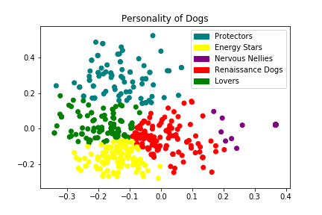
best results – K means clustering on single keyword
Dog personalities are distinctly grouped and there is specific clustering happening
Chihuahuas are grouped under “Nervous Nellies” – keywords are aloof, chewing
Alaskan Huskies are grouped under “Energy Stars” – keywords are exercise, walk, yard
There is a cluster that is showing very low numbers, but more indicative of features selected than issue with functionality of the code itself
Best silhouette scores were shown against this clustering method

Slide 9
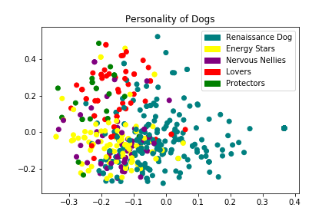
Worst results – Mean Shift on Bigram Keywords
Distinctive clustering not shown
The clusters are all over the place and not grouped consistently at all
Bigram keywords as a whole seems to have some duplicative features which is contributing to the inconsistent grouping

Slide 10
Lessons learned and use case
Lessons Learned
Use Case
Web scraping – helpful process to work through large sets of data and transform into a dataframe that can be saved as CSV for further analysis
Reduce features - should not have more features than rows
Eliminate redundant features
Evaluation techniques instrumental in determining appropriate amount of clusters
Just because you have a lot of data, it does not mean it is better
Program to allow user to type in key words and search
Based on key words typed, the program will compare against the entries where it comes up and provide a list of dogs that fit the criteria
Allows user to understand more about the breeds of dog before a decision is made
Goal is to minimize number of dogs that are returned or taken to a shelter because a person did not fully understand the breed
It is also important that the user understands what a specific dog breed needs in order to be happy

Slide 11
Conclusion
Know what you want to solve for and understand the correct techniques needed to present your analysis
Reduce data size where applicable - we want to make sure that our data sample set is manageable, but provides enough diversity so that we can see interesting patterns
When clustering, playing with different parameters can show interesting patterns in the data
Utilize evaluation techniques to determine an appropriate number of clusters you need to build into your code
Reduce features - take care to reduce duplication where possible
The possibilities are endless and this project serves as a framework for other areas where the functionality presented could be applied

Slide 12
Thank you

